Slide 1

Thyroid Disease Prediction
A Project on Machine Learning
Presented By- Somashree Sahoo
Batch- PGDA-03

Slide 2
Contents
Problem Statement
Dataset Description
Methodology
Key Findings
Conclusion

Slide 3
Problem Statements
Develop an accurate model for classifying patients with thyroid disease based on clinical and laboratory features.
Create a machine learning model to aid early detection and diagnosis of thyroid disease, benefiting healthcare professionals.
Enhance patient outcomes and alleviate healthcare burden by improving detection and management of thyroid disease.

Slide 4
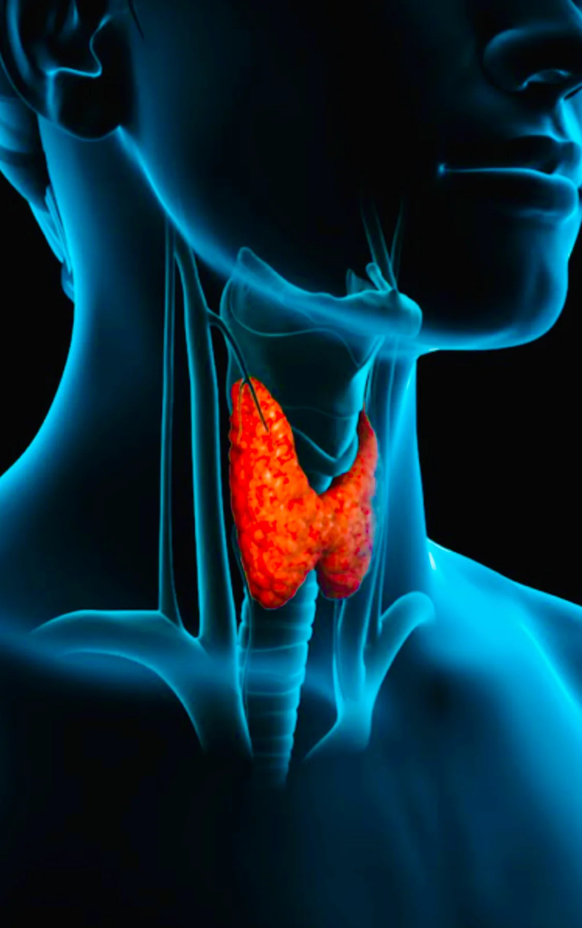
Introduction
Thyroid diseases, including hypothyroidism and hyperthyroidism, are common endocrine disorders affecting the thyroid gland.
Early and accurate diagnosis is crucial for effective
treatment of thyroid diseases.
Traditional Methods of thyroid disease diagnosis
Clinical Evaluation
Laboratory Tests
Imaging tests

Slide 5
Dataset Description
3954 Rows & 28 Columns
Target variable:
Result (1-Positive or 0-Negative)
This features indicates weather the patient has thyroid disease or not.
Independent Variables:
Continuous (Age, TSH, T3, TT4, T4U,TBG)
Category (Sex, on thyroxine, on antithyroid medication, sick, pregnant, thyroid surgery, I131 treatment, lithium, goiter, tumor, hypopituitary, psych )

Slide 6
Methodology
Data Collection , Cleaning and Preparing.
EDA and Engineering
Primary Model Building
Model Evaluation and Validation
Hyperparameter Tuning

Slide 7
EDA Report
Duplicate values, null values, and typo errors ('?') were present in the data. These issues were addressed to ensure data quality.
Outliers were retained in the dataset to avoid overlooking potential medically significant values, enabling comprehensive analysis and interpretation of the data.
Feature engineering techniques such as label encoding and scaling were applied to enhance the dataset for better modeling and analysis.
The heat map revealed a correlation between T3, TT4, and T4U thyroid tests. These tests are commonly used to evaluate the functioning of the thyroid gland.
The target variable was found to be imbalanced. To address this, SMOTE techniques were employed to balance the classes and improve model performance.

Slide 8
Model Building
Model Selection: For the classification problem at hand, the selected machine learning algorithms are Logistic Regression, Decision Tree, and Random Forest, considering factors like interpretability, scalability, and performance metrics.
Model Evaluation
Accuracy, Precision, Recall, F1 Score
Hyperparameter Tuning
Grid search CV
Optimize the Performance
Model Validation
Cross-Validation (K-fold)
Estimate the model’s Performance
Evaluate the model
Confusion matrix

Slide 9
Algorithms Report
The accuracy of the different algorithms shows minimal fluctuation, indicating stability in the predictions.
The highest accuracy achieved among the algorithms is 0.97, indicating strong predictive performance.
On the other hand, the lowest accuracy obtained is 0.95, still demonstrating a high level of accuracy in the predictions.
Logistic regression= 0.95
Random Forest Classifier = 0.97
Decision Tree Classifier = 0.96

Slide 10
Key Findings
Out of the 28 variables in the data, only 4 variables were found to significantly affect the target (Result) variable.
The plot reveals that Hyper Thyroidism cases are commonly observed in two age groups: 30-40 and 50-70 also higher in Females..
The heatmap demonstrates a significant correlation among T3, TT4, and T4U thyroid tests. These tests, widely used to assess thyroid gland functioning, exhibit a strong relationship, suggesting their collective importance in diagnosing and monitoring thyroid disorders.
The histograms provide valuable visual insights into the distributions of each thyroid test variable, enabling a better understanding of the data's characteristics.

Slide 11
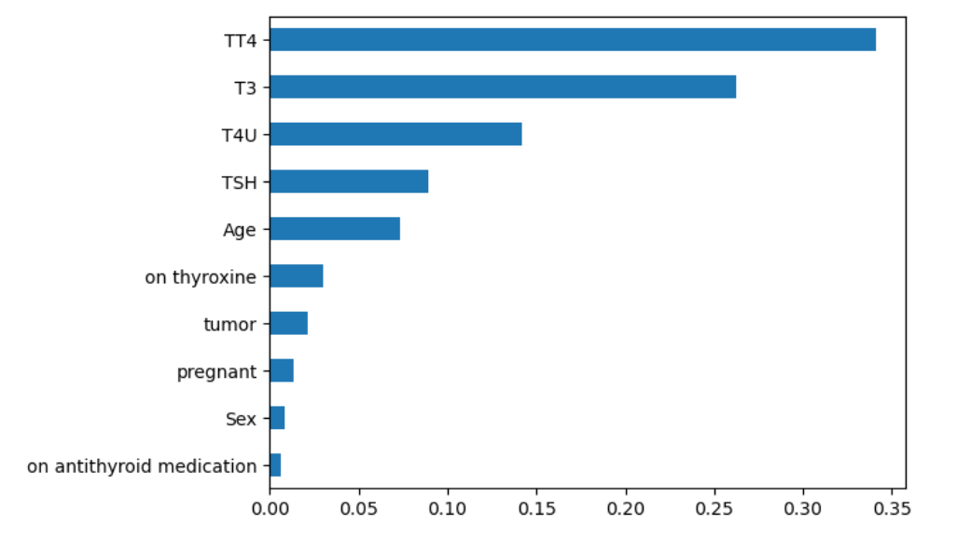
Important Features
The figure on the left represents the feature importance of each feature in relation to the target column.
Among them, the most important features are TT4 (Thyroxine), T3 (Triiodothyronine), T4U (Thyroxine Utilization Rate), and TSH (Thyroid-Stimulating Hormone). These four variables collectively contribute to over 80% of the overall feature importance.

Slide 12
Conclusion
Based on the given scores, the Random Forest model performs the best overall, with the highest train and test scores. It also has the highest recall and precision values, indicating a better balance between correctly identifying positive cases and minimizing false positives.
The Logistic Regression model has a high overall accuracy but relatively lower recall and precision values.
The Decision Tree model has perfect train score but slightly lower test score compared to the other models. In conclusion, the Random Forest model is the most effective for this particular task.

Slide 13
Suggestions
In order to capture the full spectrum of thyroid disease and its associated factors, it is important to gather a more extensive and varied dataset. This will help improve the model's accuracy and generalizability.
Consider employing more advanced machine learning techniques, to uncover complex patterns and relationships that traditional algorithms may miss.
Promote regular monitoring of thyroid tests (T3, TT4, and T4U) which can aid in the early detection, diagnosis, and effective management of thyroid disorders.
Encourage further research and collaboration between medical professionals and data scientists to gain a deeper understanding of thyroid disease.

Slide 14

Thank You

